Slide 1
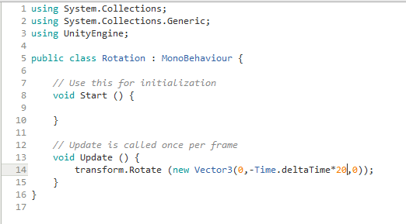
Time.DeltaTime = Real time
* = times(example 10 * 10 = 100)
Basic Unity Variables that enable use of specific feature
Name of Script, is made public so it can the accessed/referenced in other scripts.
Start Function, happens once and first
Update Function, happens continuously
This is the x, y & z values and since you need a vector 3 variable for rotation its there to.
This is us asking the object to transform its rotation

